Slide 1
BREADTH FIRST SEARCH

Slide 2
VERTEX REPRESENTATION
The vertices are named uniquely for identification
6
Various conventions for vertex naming
0
A
Marked from 0 to n-1 uniquely (Here n = 6)
***
2
2
D
1
Marked from 1 to n uniquely
1
B
3
Marked with alphabets starting from ‘A’
3
C
All the conventions are inter-changeable
5
5
F
4
4
E

Slide 3
Edge Representation
An edge is represented by the 2 end vertices
e1
1
0
e1 = (0,1) or (1,0)
e5
e2
e2 = (4,1) or (1,4)
2
e3
4
e3 = (4,0) or (0,4)
e4
3
e4 = (2,5) or (5,2)
5
e5 = (2,1) or (1,2)

Slide 4
Graph Classification
Classification based on the direction of edge
e1
e1
1
0
1
0
e5
e5
e2
e2
2
e3
e3
2
4
4
e4
3
e4
3
5
5
Undirected Graph
Directed Graph
The edges have no direction
All the edges have a direction from vertex-u to vertex-v
An edge can be represented as either (u,v) or (v,u)
Edges are represented as (u,v)
Eg: e1 can be represented as (0,1) or (1,0)
Eg: e1 must be represented as (1,0). Not (0,1)

Slide 5
Adjacent Vertex (Undirected Graph)
v is an adjacent vertex of u if an edges exists between u and v
1
0
Adjacent(0) = {1,4}
Adjacent(1) = {0,2,4}
2
Adjacent(2) = {1,5}
4
Adjacent(3) = {}
3
Adjacent(4) = {0,1}
5
Adjacent(5) = {2}

Slide 6
Adjacent Vertex (Directed Graph)
v is an adjacent vertex of u if an edges exists from u to v
Adjacent(0) = {}
1
0
Adjacent(1) = {0,2,4}
Adjacent(2) = {5}
2
4
Adjacent(3) = {}
3
Adjacent(4) = {0}
Adjacent(5) = {}
5

Slide 7
Graph Representation in Computer
2 common representation:
Adjacency Matrix
[2D Array]
Adjacency List
[Linked List]
[vector]

Slide 8
Adjacency Matrix: Directed Graph
Adjacency is represented by a 2-D array/matrix
Dimension of the matrix is n x n
1
0
[Here n = 6]
Vertices are represented by index
2
Initially all the values of the matrix are set to 0
adj
4
0
1
2
3
4
5
Now consider the edges one by one
3
0
0
0
0
0
0
0
For an edge (u,v) do adj[u][v] = 1
0
0
0
5
1
0
0
0
1
1
1
2
1
0
0
0
0
0
0
3
0
0
0
0
0
0
4
1
0
0
0
0
0
0
5
0
0
0
0
0
0

Slide 9
Adjacency Matrix: Undirected Graph
The process is almost same as before
Difference is that for an edge (u,v) do:
1
0
adj[u][v]=1
adj
2
adj[v][u]=1
4
0
1
2
3
4
5
Means u is adjacent to v
3
0
0
0
0
0
0
0
Also v is adjacent to u
1
1
1
0
0
0
0
0
0
5
1
1
1
2
1
1
0
0
0
0
0
0
3
0
0
0
0
0
0
4
1
1
0
0
0
0
0
0
5
1
0
0
0
0
0
0

Slide 10
Task
Determine whether the adjacency matrix represents a directed or undirected graph
adj
0
1
2
3
4
5
For every pair (u,v) if adj[u][v] =1 then there is also adj[v][u] =1
0
0
0
0
0
0
0
Construct the graph
1
1
1
0
0
0
0
0
0
As the matrix size is 6x6 so total vertices, n=6
1
1
1
1
0
Adj(0) = {1,4}
2
1
1
0
0
0
0
0
0
Adj(1) = {0,2,4}
2
3
0
0
0
0
0
0
Adj(2) = {1,5}
4
4
1
1
0
0
0
0
0
0
Adj(3) = {}
3
5
1
0
0
0
Adj(4) = {0,1}
0
0
0
5
Adj(5) = {2}
Undirected Graph

Slide 11
Adjacency List: Directed Graph
Each of the vertex need a separate list to store their adjacent vertices
So how many lists are required?
n
Here, n =6
1
0
list_0 contains the adjacent vertices of vertex-0
list_1 contains the adjacent vertices of vertex-1
2
.
.
4
.
3
list_i contains the adjacent vertices of vertex-i
This concept can be generalized by declaring an array of list of size n
5
list[0]
1
list[3]
NULL
list[1]
2
4
list[4]
0
list[2]
5
list[5]
NULL

Slide 12
Adjacency List: Undirected Graph
list[0]
1
4
1
0
list[1]
0
2
4
2
list[2]
4
1
5
3
list[3]
NULL
5
list[4]
0
1
list[5]
2

Slide 13
Input of Directed Graph
First input: Number of vertices, n
Here, n = 5
Second input: Number of edges, e
Here, e = 6
1
0
Now take e number of edges as input in form of u v
1 2
0 1
1 3
3 2
3 0
2 4
Adjacency Matrix
Adjacency List
2
3
cin >> n;
int adj[n][n];
cin >> e;
cin >> n;
vector<int>adj[n];
cin >> e;
for(i=1; i<=e; i++){
}
for(i=1; i<=e; i++){
}
cin >> u >> v;
adj[u][v]=1;
cin >> u >> v;
adj[u].push_back(v);
4
0
1
2
3
4
adj[0]
1
0
1
0
0
0
0
0
adj[1]
2
3
0
0
0
0
0
1
1
1
adj[2]
4
0
0
0
0
0
2
1
1
1
adj[3]
2
0
3
0
0
0
0
0
4
0
0
0
0
0
adj[4]

Slide 14
Input of Undirected Graph
Adjacency Matrix
Adjacency List
cin >> n;
int adj[n][n];
cin >> e;
cin >> n;
vector<int>adj[n];
cin >> e;
1
0
for(i=1; i<=e; i++){
}
for(i=1; i<=e; i++){
}
cin >> u >> v;
adj[u][v]=1;
cin >> u >> v;
adj[u].push_back(v);
adj[v][u]=1;
adj[v].push_back(u);
2
4
3
5

Slide 15
Task
Find the adjacent vertices of vertex-3
Adjacency Matrix
Adjacency List
1
0
0
1
2
3
4
adj[0]
1
2
0
1
0
0
0
0
0
3
0
0
0
0
0
adj[1]
2
3
1
1
1
0
0
0
0
0
adj[2]
4
2
1
1
1
4
3
0
0
0
0
0
adj[3]
2
0
4
0
0
0
0
0
adj[4]
for(i=0; i<n; i++){ //n=5 here
}
for(i=0; i<adj[3].size(); i++){
}
if(adj[3][i]==1) {printf(“%d “, i);
printf(“%d “, adj[3][i]);

Slide 16
Questions and Answers
Is the adjacency sequence same for Adjacency matrix and Adjacency list method?
May not be same
Adjacency matrix provides sorted sequence of adjacent vertices
Adjacency list preserves the input sequence of adjacent vertices
How to check whether an edge (u v) exists in a graph or not?
Adjacency matrix:
Adjacency list:
if(adj[u][v]==1)
printf(“Edge exists”);
for(i=0; i<adj[u].size(); i++){
}
else
printf(“Edge exists”);
if(adj[u][i]==v)
printf(“Edge exists”);
else
printf(“Edge exists”);
Which one is better approach to represent a graph between Adjacency Matrix and Adjacency List?
Think

Slide 17
LINEAR SEARCHING
Array Searching
Searching is direction-wise
Direction can be defined as
Forward to backward
0
1
2
3
0
1
2
3
Backward to forward
Forward to backward
Backward to forward
Head to tail
Tail to head
Linked List Searching
head
tail
head
tail
head to tail
tail to head

Slide 18
GRAPH SEARCHING
Is forward to backward searching possible?
No
Because there is no unique first element
As well no unique last element
Also no linear ordering
Linear searching is not possible in graphs
Possible searching methods:
Level wise searching
Depth wise searching

Slide 19
LEVEL OF A VERTEX
source
Source indicates the starting vertex
0
Can be chosen randomly
Can be fixed based on the problem statement
Here source has been chosen randomly
1
1
1
level(source) = 0
level(vertex) = 1 + level of it’s predecessors
2
2
2
When a vertex has a unique predecessor

Slide 20
LEVEL OF A VERTEX
source
level(source) = 0
0
level(vertex) = 1 + minimum level of it’s predecessors
When a vertex has multiple predecessors
1
1
1
1
2
2
Level of predecessors = {0, 1}
Min level of predecessors = 0
level = 1 + 0 = 1

Slide 21
EXERCISE
Write down the level of the vertices
Level-0
6
7
Level-1
8
2, 3
1
4
Level-2
5
0, 1, 5
0
Level-3
2
3
7, 8
6
Level-4
4
source

Slide 22
PARENT CHILD RELATION
Parent of B is A, if the level of B is set by A
Level-0
6
7
Level-1
8
One vertex can have multiple child
2, 3
1
4
Level-2
5
0, 1
, 5
But one vertex can not have multiple parent
0
Level-3
2
3
7
, 8
6
Level-4
4
source

Slide 23
LEVEL FINDING
Propose a method to find the level of each vertex where the source is given (Here source = A)
source
A vertex v passes 2 phases
A
Level of v is set by some other vertex u
v sets the level of some other vertex w
B
C
At phase-1: v becomes the child of u
At phase-2: v becomes the parent of w
E
F
D

Slide 24
LEVEL FINDING
Propose a method to find the level of each vertex where the source is given (Here source = A)
source
A vertex v passes 2 phases
A
Level of v is set by some other vertex u
v sets the level of some other vertex w
B
C
At phase-1: v becomes the child of u
At phase-2: v becomes the parent of w
E
F
D

Slide 25
LEVEL FINDING
Propose a method to find the level of each vertex where the source is given (Here source = A)
source
There is a story
0
A
There is a “khela hobe” line for juniors (FIFO)
All the students must be played by their senior
When a junior exits from the “khela hobe” line, s/he becomes senior
1
B
C
1
Then that senior pushes his/her juniors in the “khela hobe” line for fun
Source is the first person to enter the “khela hobe” line
2
E
2
F
2
D
Senior:
A
NULL
E
F
B
D
C
Level:
0
A
C
C
B
E
NULL
F D
1
E
2
D
F
D
1
2
END
2
F, D
Junior:
E
B, C
NULL
A
NULL
NULL
Write down the seniority sequence

Slide 26
LEVEL FINDING
source
Find the seniority sequence of this graph
A
B
C
E
F
D

Slide 27
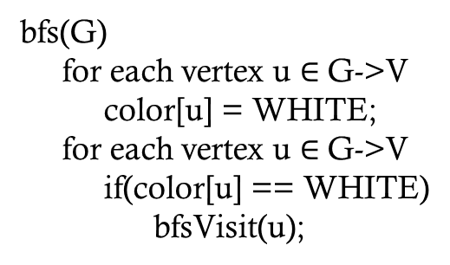
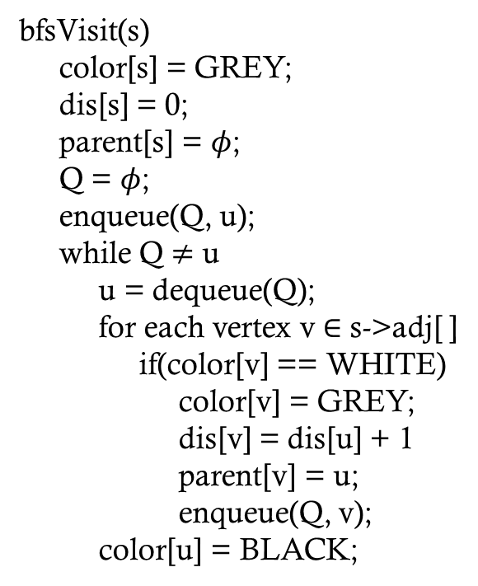
Breadth First Search
bfs(G)
for each vertex u $∈$ G->V
color[u] = WHITE;
for each vertex u $∈$ G->V
if(color[u] == WHITE)
bfsVisit(u);
bfsVisit(s)
color[s] = GREY;
dis[s] = 0;
parent[s] = $φ$;
Q = $φ$;
enqueue(Q, u);
while Q $≠$ u
u = dequeue(Q);
for each vertex v $∈$ s->adj[ ]
if(color[v] == WHITE)
color[v] = GREY;
dis[v] = dis[u] + 1
parent[v] = u;
enqueue(Q, v);
color[u] = BLACK;
A
D
A
D
A
D
B
B
B
C
E
C
E
C
E
A
D
B
E
C
D
E
B
King =
A
C

